Slide 1

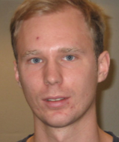








Efficient Demand Evaluation of Fixed-Point Attributes using Static Analysis
Idriss Riouak, Niklas Fors, Jesper Öqvist, Görel Hedin and Christoph Reichenbach Lund University, Cognibotics, Lund, Sweden
SLE 2024
Pasadena, California, USA
20-10-2024
Notes:
Hello everyone, my name is Idriss Riouak and today I will talk about our paper Efficient Demand Evaluation of Fixed-Point Attributes using Static Analysis. This is a joint work with Niklas Fors, Jesper Oqvist, Gorel Hedin and Christoph Reichenbach.

Slide 2
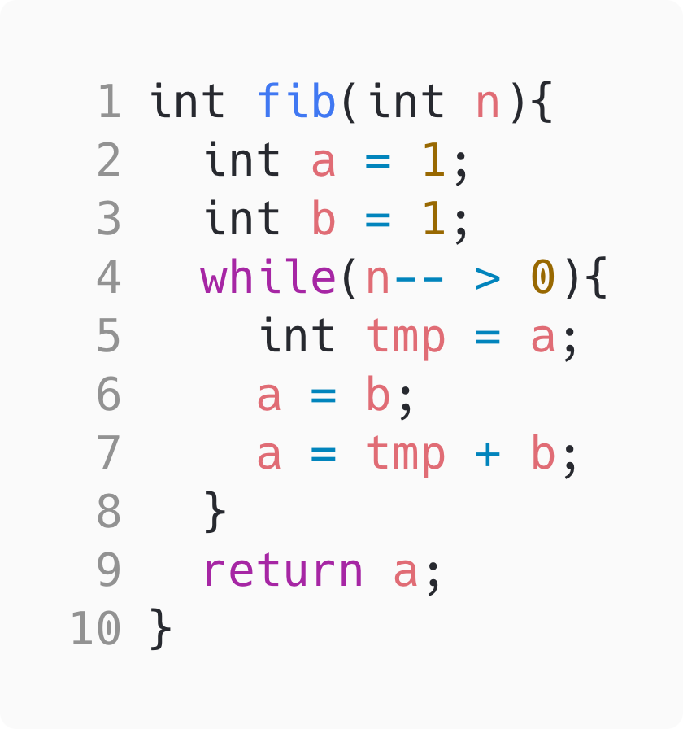
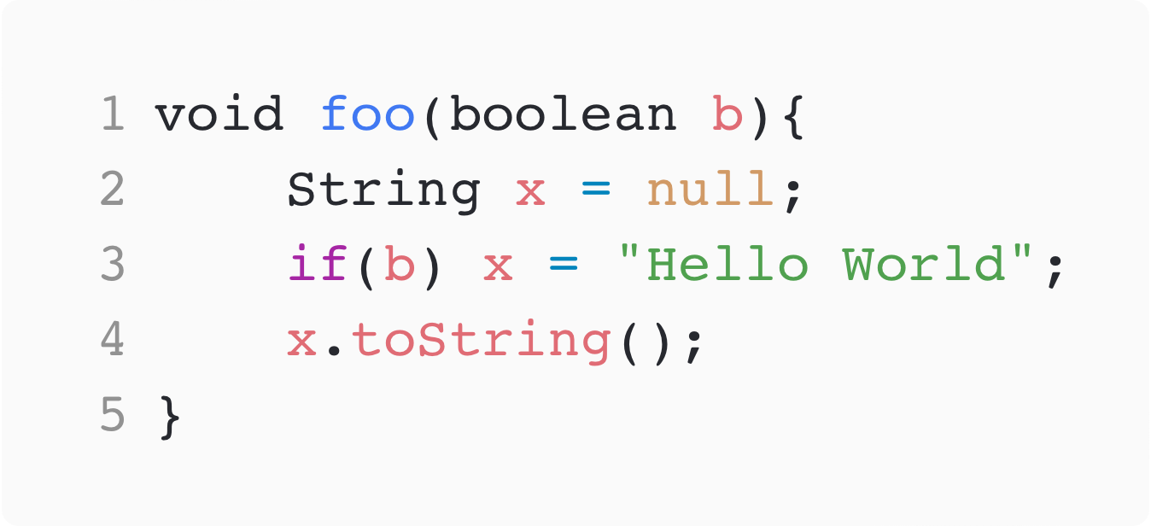

Static Analysis is Everywhere !
We can use static analysis to detect, e.g., common weaknesses:
🐞
‘a=b’ is dead.
🐞
‘x’ might be null
Notes:
So let’s start. I ho pe you agree with me that Static Analysis is Everywhere and we can use Static Analysis to, for example, detect bugs in our code.
Let’s consider, the following piece of code which is supposed to compute the n-th number of the fibonacci sequence. A good static analyser would tell use that “Hey! The assignment at line 6 is dead” (so you are never using the value assigned to a. Let us consider this other example, where depending ot the value of b we might get a null pointer exception. If b is false, we never initalise x and when we tri to access the method toString we get a null point exception. Also here, a good static analyser would tell us that that.
Now, we ideally would like to identify these bugs while we are writing or editing the code. To do so, we not only need a fast static analyser, but we also need a static anlayser that supports demand-driven

Slide 3
How to implement a static analyzers ?
Imperative way:
Focus: How to compute the analysis results
Responsibility: Developer handles all implementation details
Examples: SonarQube, Clang Static Analyser, PMD, Éclair, Coverity, PVS-Studio, Infer …
Declarative way:
Focus: What the analysis results should be.
Responsibility: Implementation details are delegated to the compiler.
Examples: Astreè, CodeQL, JavaDL, IncA, OPAL, …
Reference Attribute Grammars
Notes:
Among all the possible delcarative formalims we used RAGs as they inherently support demand-driven evaluation. Analysis developer
Spoofax
Remove responsabilites Remove this

Slide 4


On-Demand vs Exhaustive Evaluation
On-Demand Evaluation
Only computes the specific results needed for a query
More efficient for interactive tools (e.g., code editors)
Exhaustive Evaluation
Compute all data, even if not required
Inefficient for large-scale codebases
Results in longer processing times and unnecessary computations.
We used JastAdd: A Reference Attribute Grammar System
Notes:
Demand driven is the dual of Exausthive evaluation. Where we compute all data …Think of yourself

Slide 5
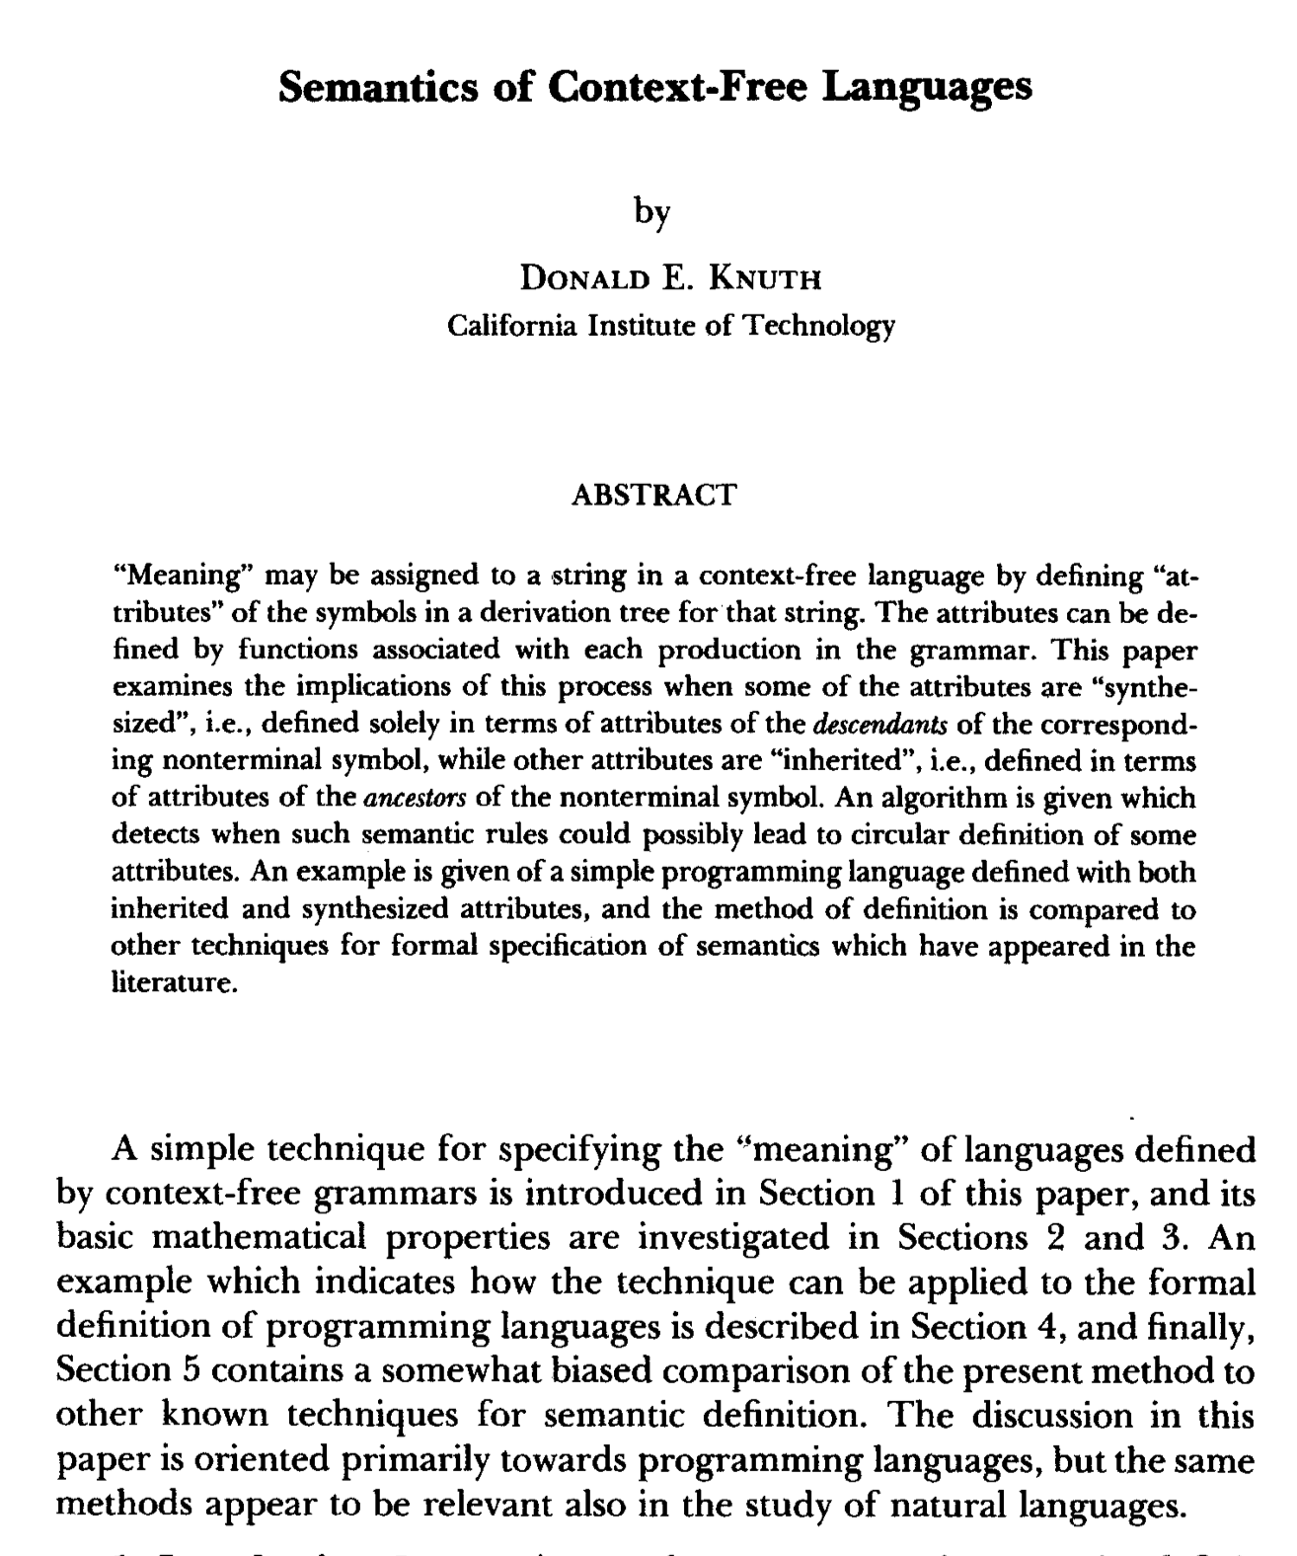
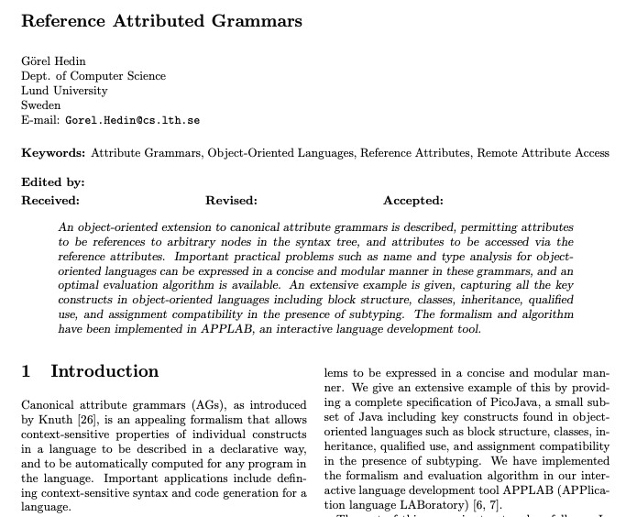
Attributes
Attributes are derived properties associated to AST nodes.
fib
int a = 1
int b = 1
while
return a
n-- > 0
int tmp = a
a = b
a = tmp + b
isDead
= true
fib
int a = 1
int b = 1
while
return a
n-- > 0
int tmp = a
a = b
a = tmp + b
Notes:
And then extended to the OO paradigm by GH

Slide 6
JastAdd: A Reference Attribute Grammar System
JastAdd supports RAGs.
Some examples of projects that use JastAdd:
ExtendJ: Java 11 compiler
IntraJ: Intraprocedural dataflow analysis
Bloqqi: Visual automation language
JModelica: Industry-strength Modelica compiler
...
Notes:
CP font and italics. Some examples
Remove CAT & CP
Modlica
Bloqqi

Slide 7
Let’s go back to static analysis

Slide 8
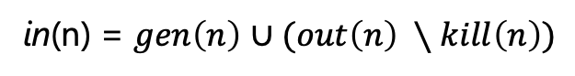
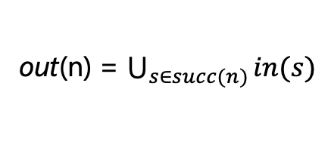
Dataflow Analysis
Most dataflow analyses are instances of the monotone framework.
Now, let’s define the equations for a backward dataflow analysis
isDead
in
out
in(n) = $gen\left(n\right)$ $∪(out\left(n\right) ∖kill\left(n\right))$
out(n) = $\bigcup_{s∈succ(n)}{in(s)}$
gen
kill
succ
Each of these functions can be implemented as an attribute.
Notes:
This is the static graph. In reality we would have many more instances. Each of these functions can be implemented as attributes

Slide 9
Dataflow Analysis with RAGs
Let us consider the following program:
fib
int a = 1
int b = 1
while
...
in
out
in
out
n-- > 0
in
out
int tmp = a
a = b
a = tmp + b
in
out
in
out
in
out
In order to compute in and out we have to compute a fixpoint!
Notes:
Fix analysis
Dynamic dependency graph

Slide 10
Circular Attributes
Are attributes which value may depend on itself directly or indirectly.
How do Circular Attributes work?
Circular attributes are evaluated using fixed-point computations.
The analysis start with a bottom value and iteratively updates the result until it stabilizes.
Notes:
Attributes

Slide 11
How can we efficiently compute a demand-driven fixed-point attribute ?
There has been a lot of research on Circular Attributes:
1968 – Knuth: circular attributes were not allowed
1986 – Farrow & Jones et al.: introduced circular but well-defined attribute grammars
1996 – Boyland: describes demand-driven evaluation for circular attributes
2002 – Sasaki and Sassa: described exhaustive circular evaluation for remote attribute grammars
2003 – Magnusson et al.: introduced BasicStacked, the first Circular RAG algorithm
2017 – Öqvist et al.: introduced RelaxedMonolithic to overcome limitations of BasicStacked
Today – Riouak et al.: introduce RelaxedStacked
RelaxedStacked
Demand-driven algorithms
Notes:
Are basically RAGs but reference have to be set at compile time.
BaiscStack
RM

Slide 12
The BasicStacked Algorithm
isDead
NC
This algorithm was introduced by Magnusson et al:
It allows two kind of attributes:
Circular:
Trigger a fixed-point computation.
Non-Circular:
Evaluated and immediately cached.
The user needs to manually annotate all Circular attribtues
in
out
C
C
gen
kill
succ
NC
NC
NC
Notes:
Circular first
Two kinds of attribtues

Slide 13
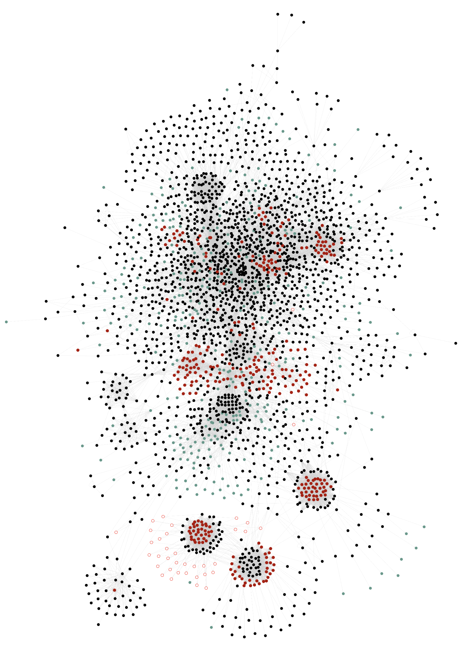
The BasicStacked Algorithm
Main problems:
Some attributes exhibit circular behavior occasionally but we still pay for a costly fix-point computation.
Annotating each attribute is error-prone for large projects.
Complexity of the ExtendJ Java Compiler.
2597 Attributes connected by 26222 edges
Notes:
infeasible
Type. Remove text

Slide 14
The RelaxedMonolithic Algorithm
isDead
A
This algorithm was introduced by Öqvist et al:
It allows two kind of attributes:
Circular:
They trigger a fixed-point computation.
There must be at least one attribute annotated as circular in every possible cycle.
Agnostic:
Behaves as non-circular when no circular evaluation is ongoing
Behaves as a circular when invoked within a circular evaluation
in
out
C
A
gen
kill
succ
A
A
A
Notes:
Remove Non-circular

Slide 15
The RelaxedMonolithic Algorithm
Main problem:
Once the algorithm encounters a circular attribute, it will treat all subsequent attribtues as circular
Therefore, the fixpoint evaluation is performed in a single monolithic fix point computation
Queried
Evaluated 20 times
isDead
A
Needs 20 iterations
C
in
out
A
Needs 10 iterations
gen
kill
succ
isReachable
reachable
Evaluated once
A
A
A
A
C
Notes:
Animate isDead
needs 10, needs 20

Slide 16
Our approach: the RelaxedStacked Algorithm
Our new algorithm enables the coexistence of all three types of attributes:
Circular
Non-Circular
Agnostic
Algorithm | Supported Attributes | Decompose Static SCCs | Annotation Effort
BasicStacked | Circular Non-Circular | Yes | High
RelaxedMonolithic | Circular Agnostic | No | Low
RelaxedStacked | Circular Non-Circular Agnostic | Yes | ?
Low with the use
of static analysis
Key Idea: If an agnostic or circular attribute is known not to participate in a circular evaluation, it can be re-classified as non-circular.
Notes:
That we are sure are not in a cycle
It can be treated as non-circular
Re-classified as non-circular
Decompose Static SSCs

Slide 17
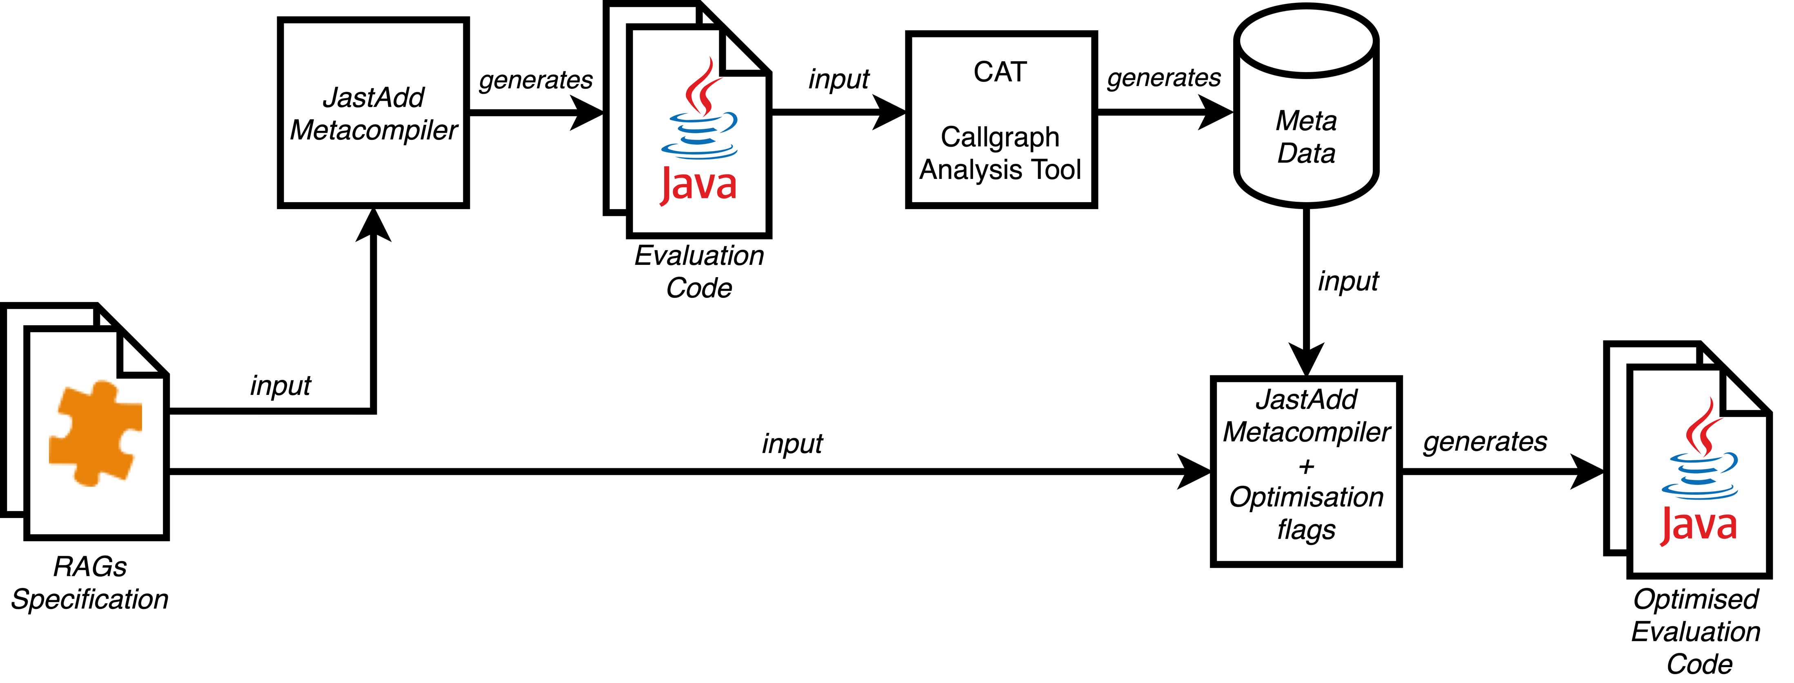
Using Static Analysis to Classify Non-Circular Attributes

Slide 18
Let’s go back to dataflow
From the Java code generated by JastAdd, we construct the callgraph.
We compute SCCs and identify definitively Non-circular attributes.
A trivial SCC is a SCC with a single node not connected to itself.
Queried
isDead
NC
A
Evaluated 20 times
Needs 20 iterations
C
in
out
A
Stops onging
circular evaluation
Needs 10 iterations
gen
kill
succ
isReachable
reachable
NC
NC
NC
NC
C
A
A
A
A
Evaluated once
Notes:
Lookup name of trivial component
Evaluation program

Slide 19


Evaluation Overview
We compared our new algorithm, RelaxedStacked, with the two existing algorithms: BasicStacked and RelaxedMonolithic.
Importantly, we did not modify the analyses (i.e., RAGs specification).
We evaluated the three algorithms on the following case studies:
LL(1) parser construction
ExtendJ Java compiler:
No overhead, even in fully annotated or few circular attribute applications.
IntraJ static analyser
Notes:
No overhead with fully anotate application like LL1 parser constructions

Slide 20
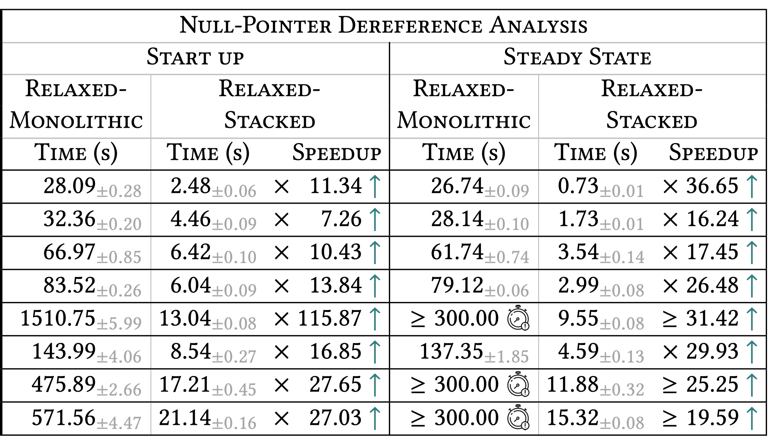
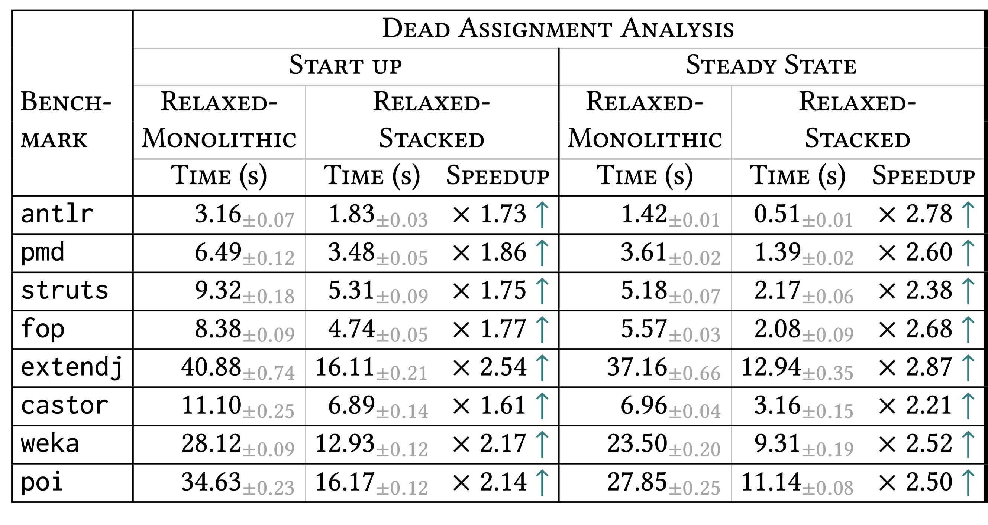
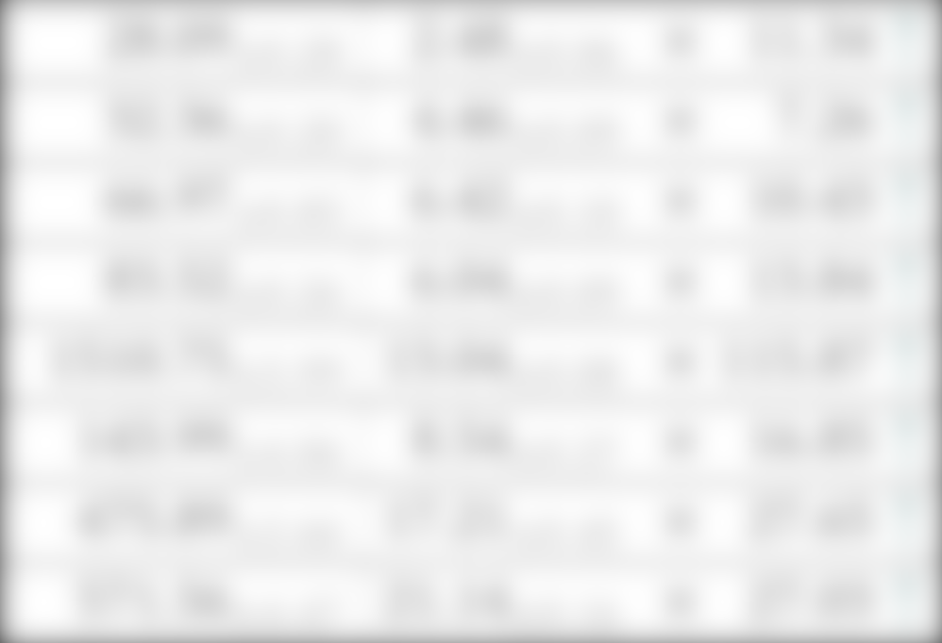
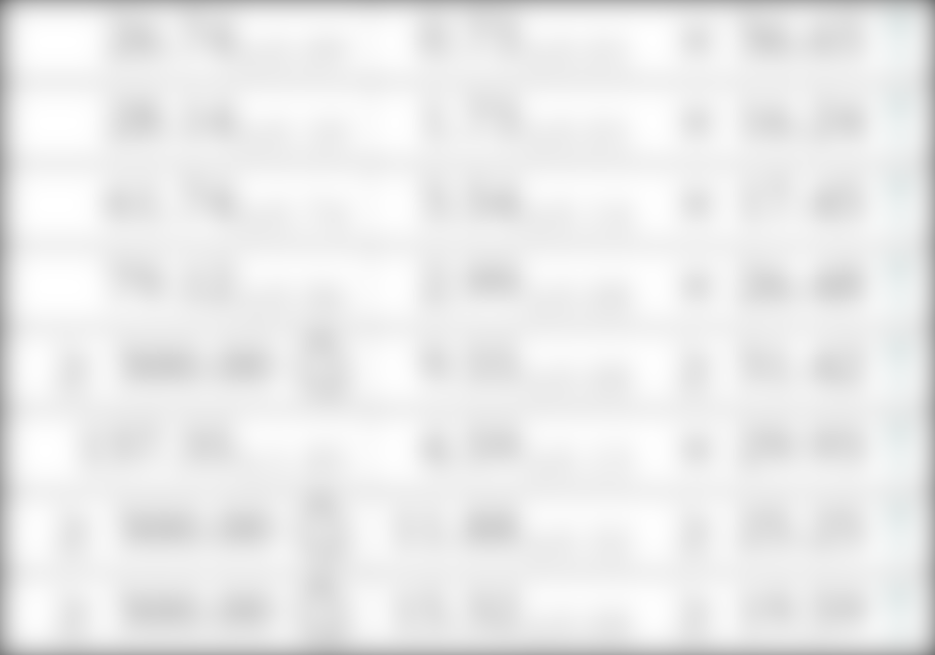
Case Study: IntraJ Static Analyser
Goal: Compute intraprocedural null-pointer dereference analysis for Java program
Background: IntraJ is built upon ExtendJ
Comparison: RelaxedStacked vs. RelaxedMonolithic
Start Up: speedup between ~7x to ~115x, with a median of ~15x.
Steady State: speedup between ~16x to ~35x, with a median of ~22x.

Slide 21
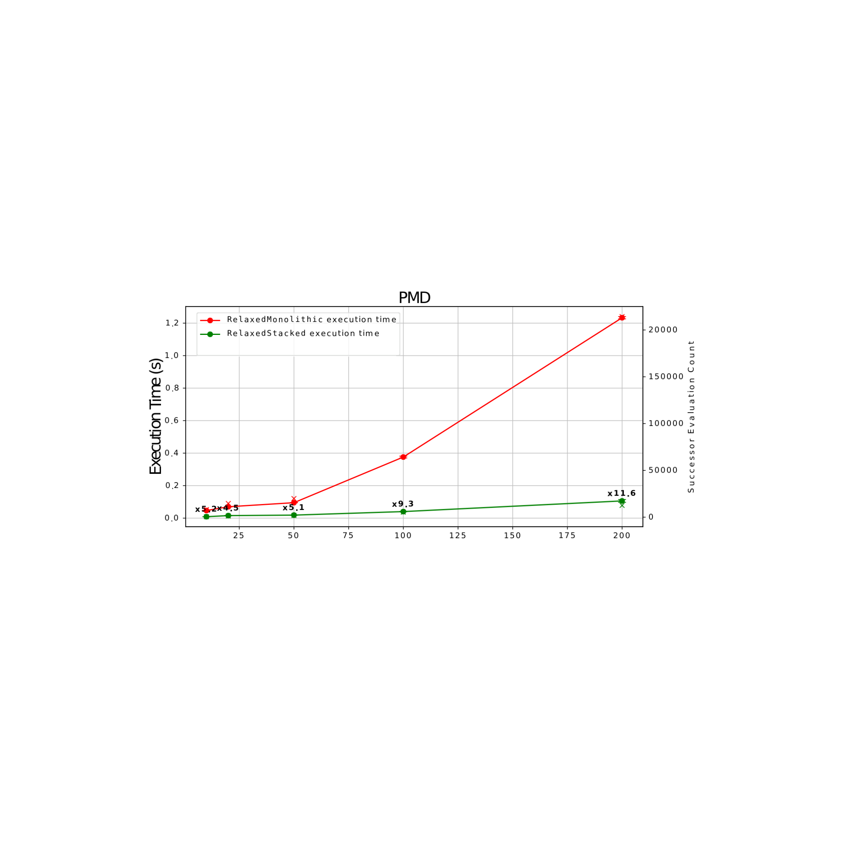
What about demand-driven scenarios ?
Randomly selected methods:
We analysed 10 – 20 - 50 - 100 – 200 methods
Compute Null-pointer dereference analysis
# Methods

Slide 22
Conclusion and Future Work
Main Contributions:
We introduced a new algorithm, RelaxedStacked, designed to improve the evaluation of circular attributes.
Using static analysis, we could reclassify a number of circular and agnostic attributes as non-circular, optimizing performance.
Our algorithm achieved faster execution times compared to existing approaches like BasicStacked and RelaxedMonolithic.
We maintained compatibility with the original RAG spec, requiring no additional changes.
Future Directions:
Explore dynamic SCC detection to further optimize the evaluation of circular attributes.
Explore use of other types of static analyses, increasing the precision of our approach.
Notes:
So, to conclude, let me summarise our main contributions: we introduce a new algorithm called RelaxedStacked, which is designed to improve the evaluation of circular attributes

Slide 23

Thank you for your attention!
CONTEXT
Demand-driven fixed-point implementations can be automatically generated; ideal for implementation of static analysis.
PROBLEM
Existing algorithms are either error-prone, or inefficient when applied large systems with many circular dependencies.
SOLUTION
We propose a new algorithm that combines the best of previous approaches, using static analysis to identify attributes that are guaranteed non-circular.
RESULTS
Our results show a significant speedup median of 15x (start-up) and 22x (steady-state) for dataflow analysis.
Link to the article!
Notes:
Stronger conclusion. Annotate obviously circular attribtues. Faster execution

Slide 24
Steady State Timeout
For startup we collect 50 datapoints.
For steady state we still collect 50 datapoints but before collecting them we reach
a steady state by discarding the first 24 iterations.
For a total of 50x25=1250 iterations for steady state.

Slide 25
Limitations
Static Analysis: we overapproximate the callgraph of the analysed program.
isConst
Expr.isConstant() = getLeft().isConstant() && getRight().isConstant()
A

Slide 26
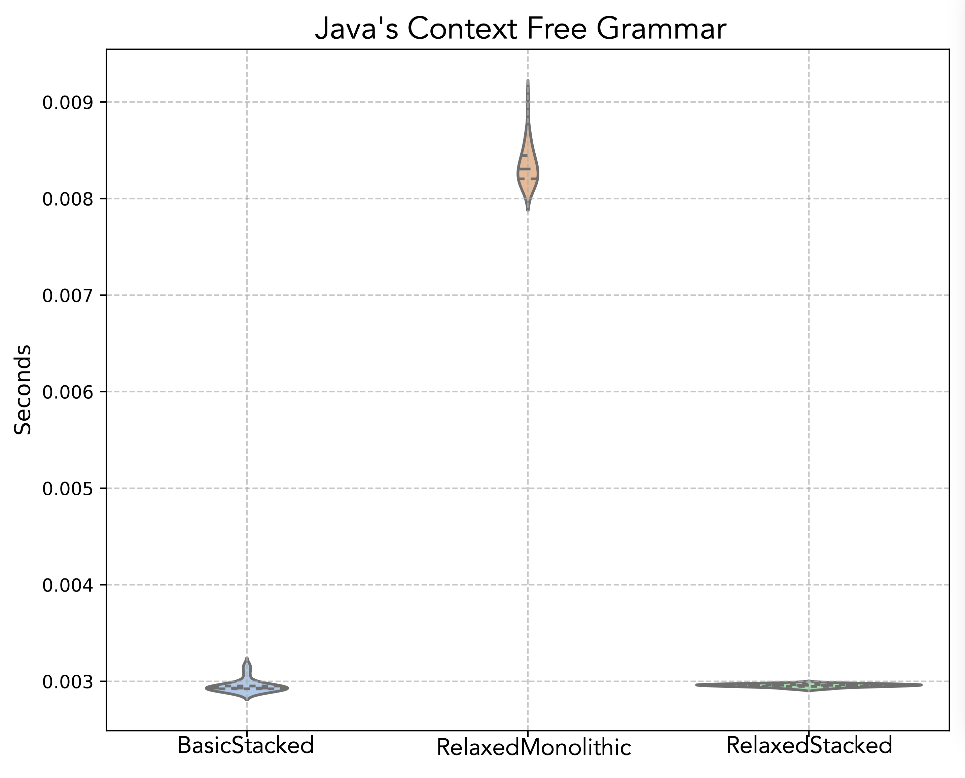
Case Study 1: LL(1) parser construction
Goal: Compute Nullable, First and Follow sets.
Background: This case study was based on the artifact from Magnusson (2003). (Make Your Research Open). Comparison: RelaxedStacked vs. BasicStacked vs. RelaxedMonolithic.
RelaxedStacked is as fast as the BasicStacked.
And it ~2.8x faster than the RelaxedMonolithic.

Slide 27
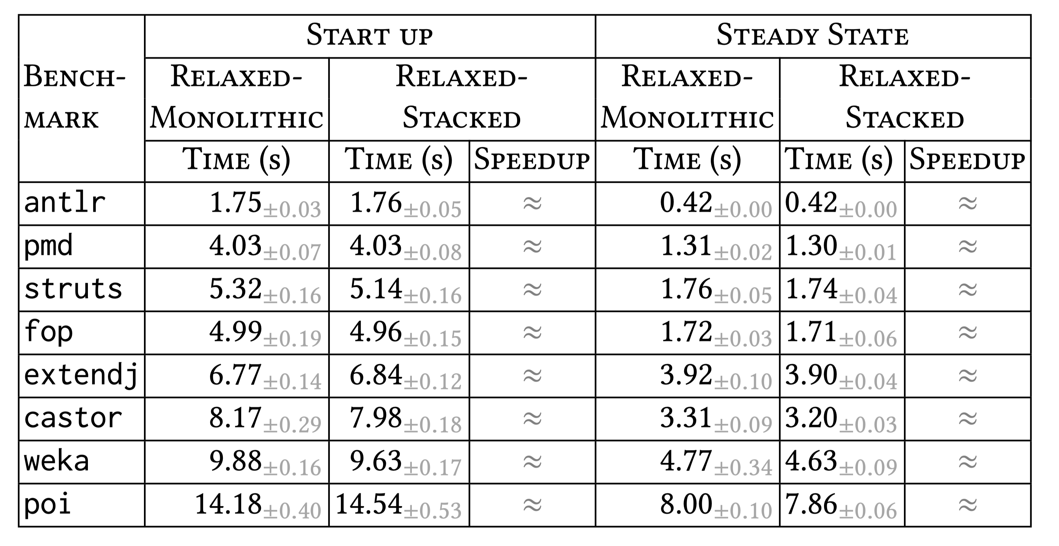
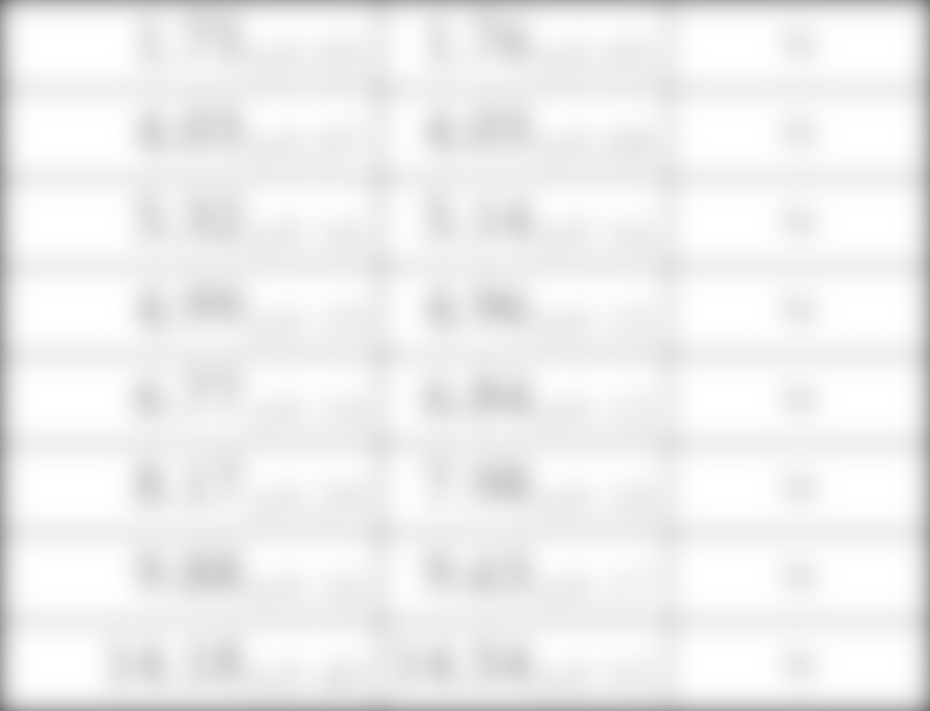
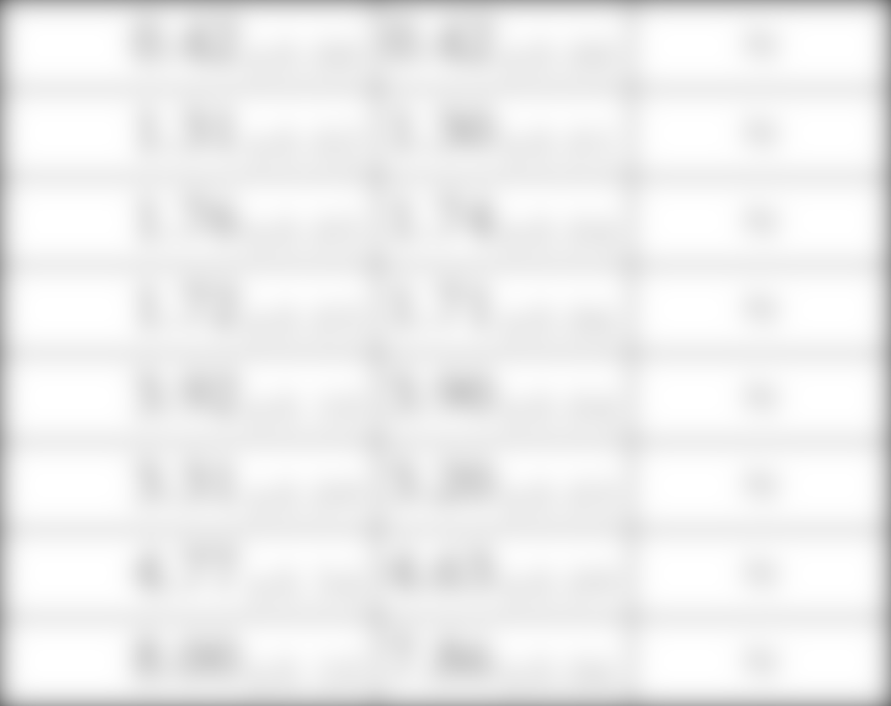
Case Study 2: ExtendJ Java Compiler
We inspected the ExtendJ source code and found it uses very few circular attributes. Still, experiments show that our algorithm introduces no additional overhead.

Slide 28
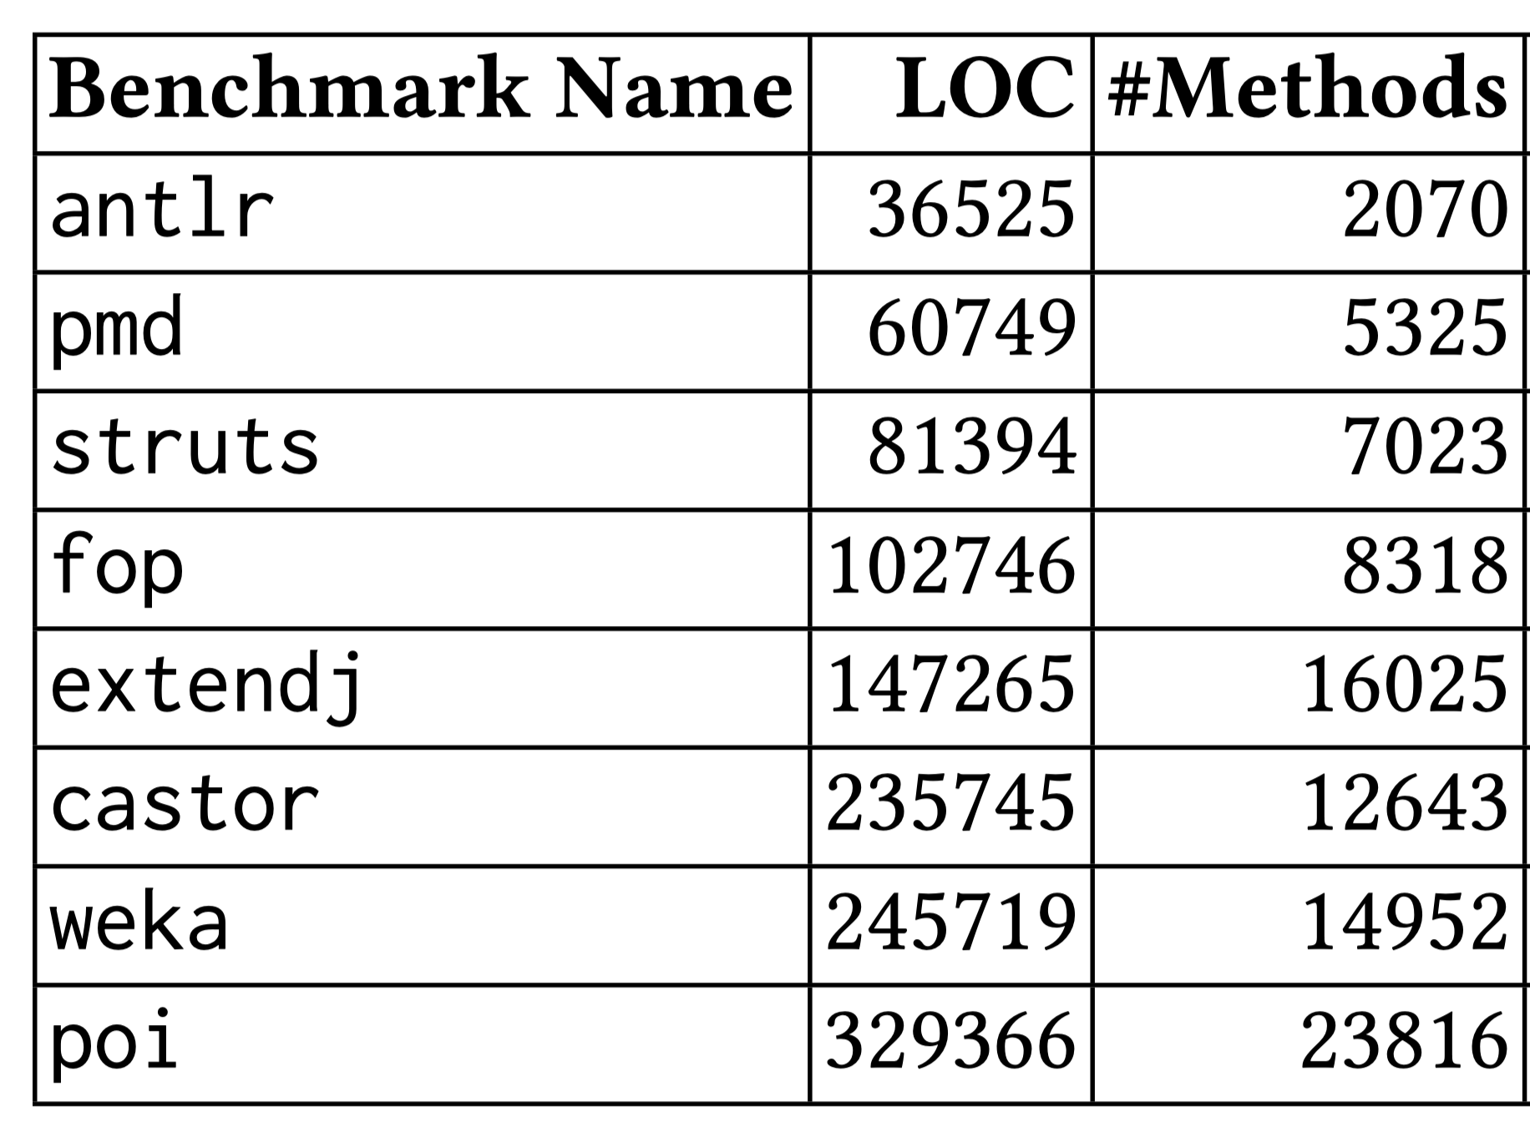
Case Study: IntraJ Static Analyser
Goal: Compute intraprocedural null-pointer dereference analysis for Java program
Background: IntraJ is built upon ExtendJ
Comparison: RelaxedStacked vs. RelaxedMonolithic

